Slide 1
Integrating E-Learning and Open Educational Resources into Classroom

Slide 2
Introduction
Nowadays our world is technologically advancing at a very fast rate and modern education has to make some essential changes in order to reach these high standards.
I’m a chemistry teacher in the Second English Language School "Thomas Jefferson“ . During my classes I not only use traditional teaching methods but I also seek to use information communications technology (ICT). This way I can better visualize the chemical processes and make the lessons more fun and interactive for the students.

Slide 3
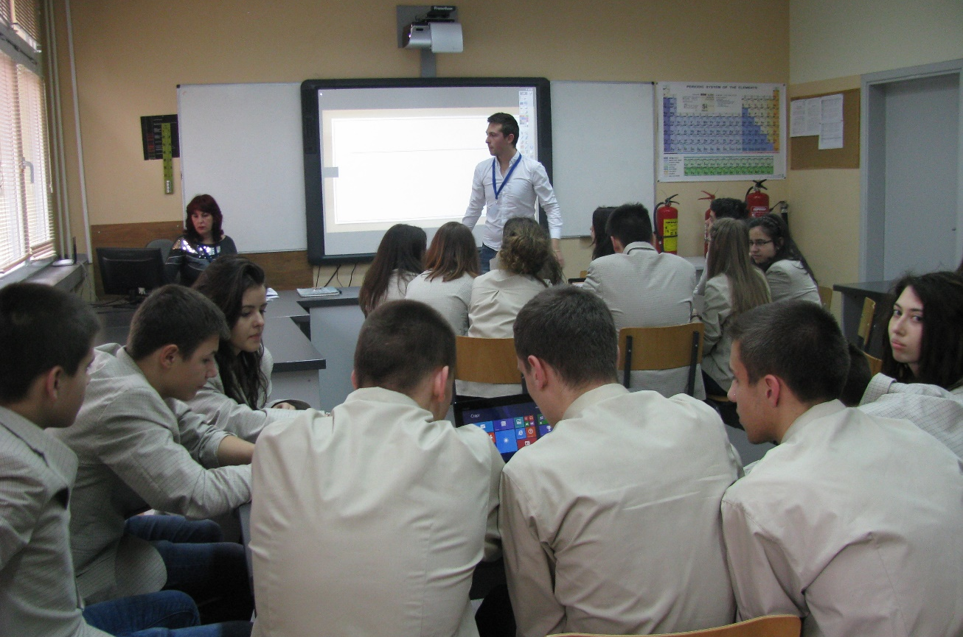
ICT
In my classroom I have three different types of information communications technology, which can be used both by me and my students:
Computer
Interactive whiteboard
Tablets

Slide 4
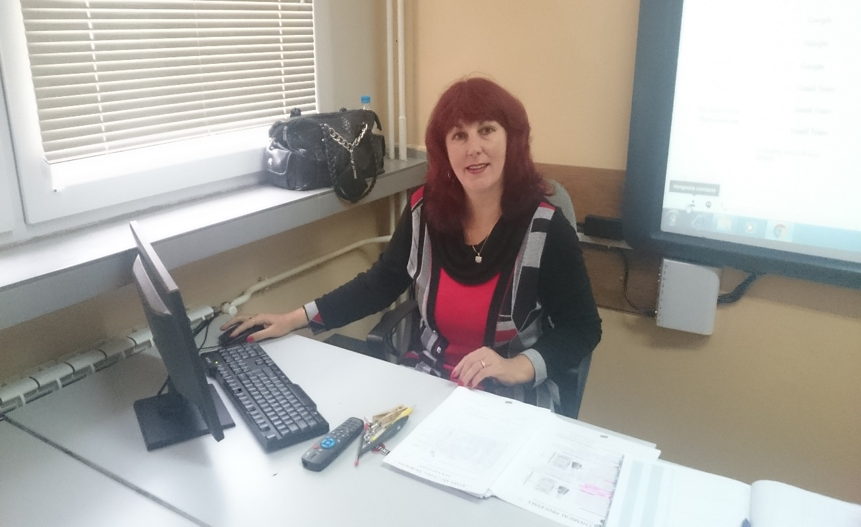
Computer
I use my computer for:
- Storing all my information
Creating presentations
Finding information on the web

Slide 5
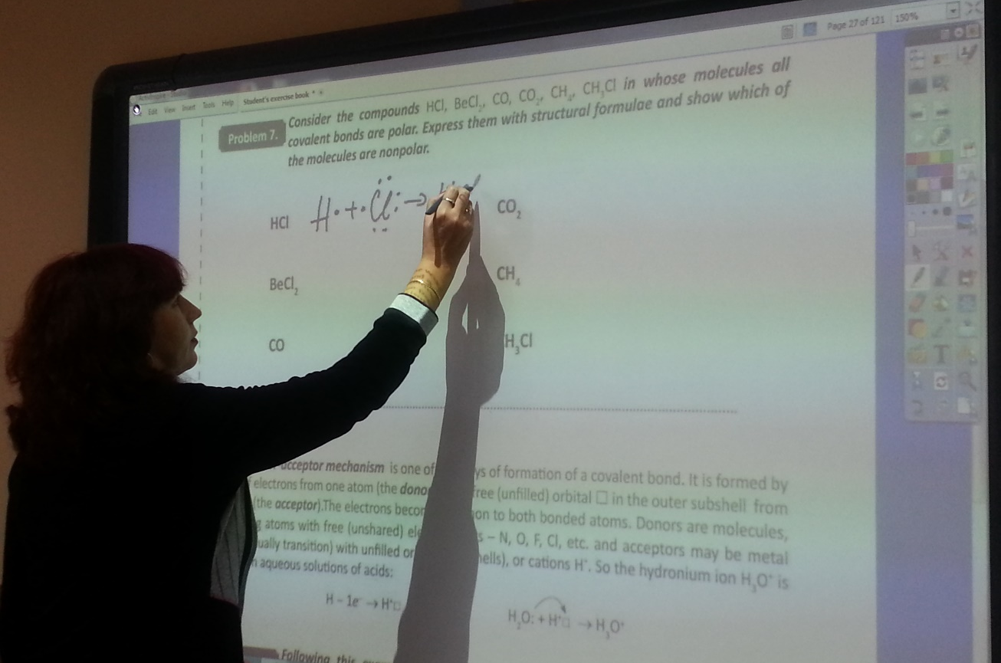
Interactive whiteboard
The interactive whiteboard is a multifunctional device which is attached to my computer. It is used to show my computer screen while also being a board on which I can write.

Slide 6
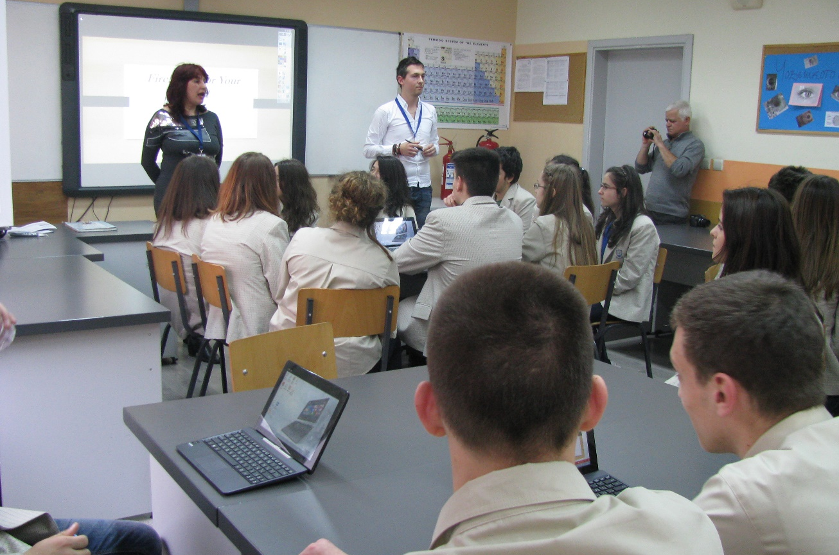
In my classes I use the interactive whiteboard to represent my lessons and with the use of a pen I can highlight and change the colour of the important facts so that my students can memorize them easily.

Slide 7
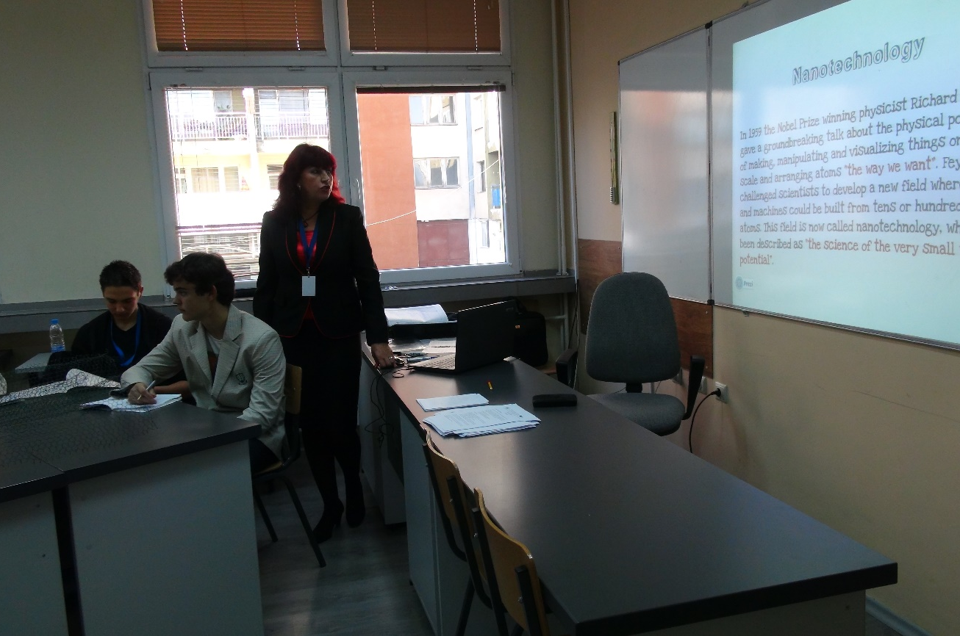
I use the interactive whiteboard to:
Show my own presentations
View students presentations
And preview presentations from other schools

Slide 8
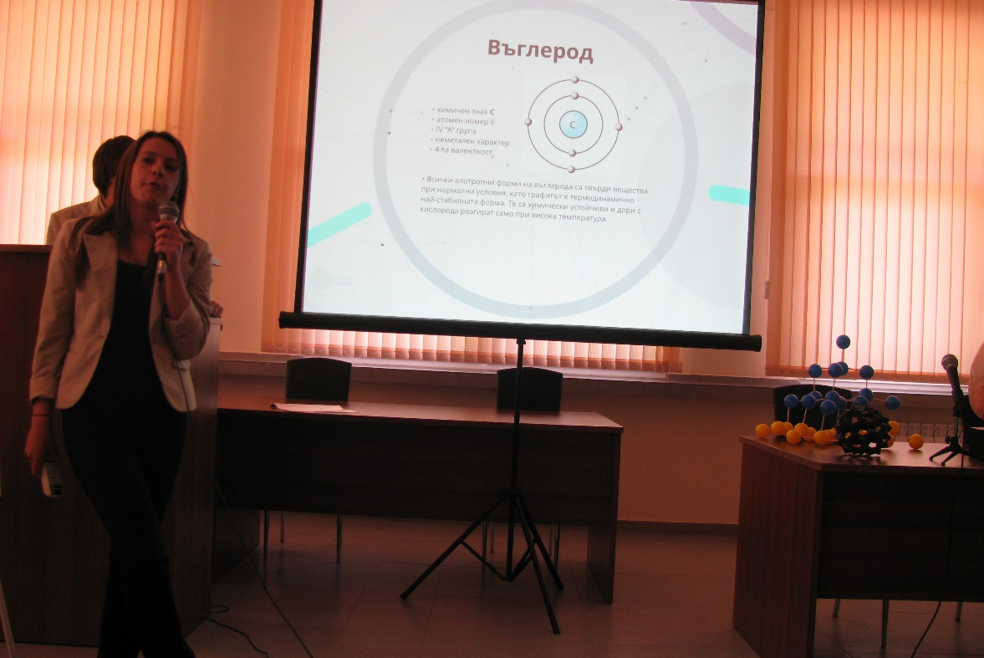
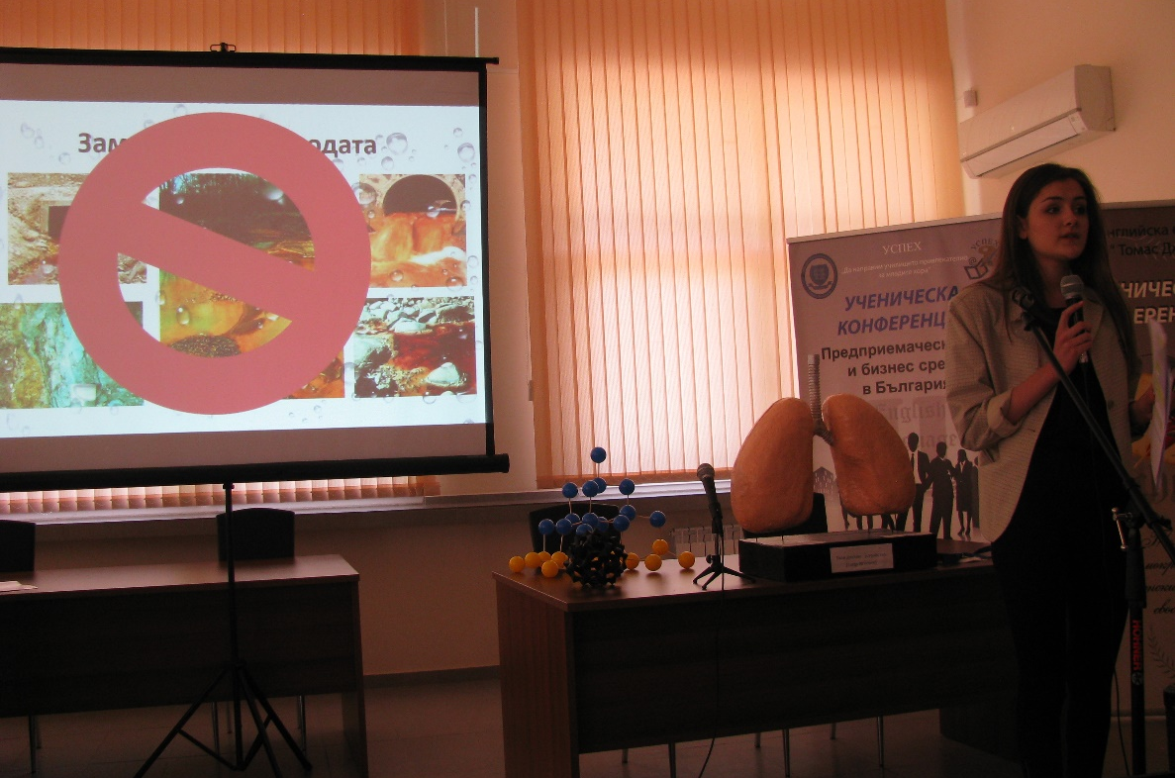
Science fair in our school

Slide 9
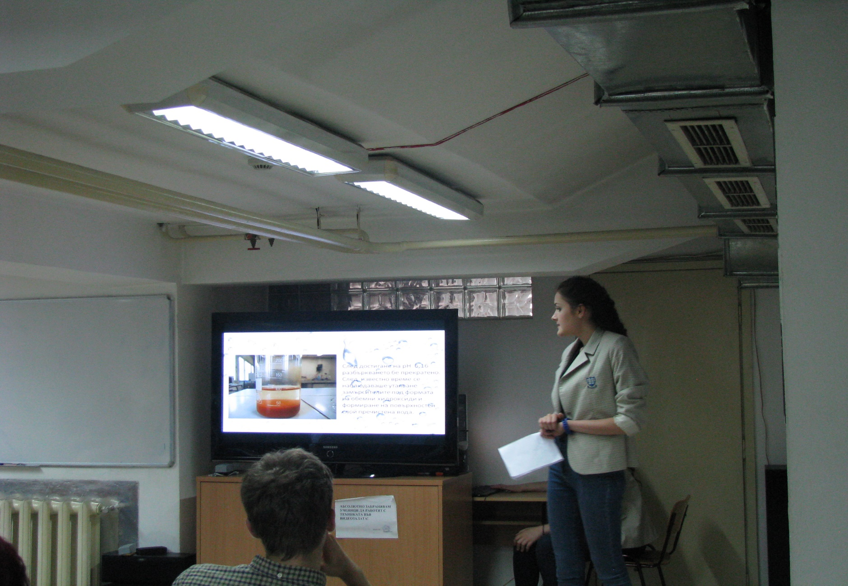
My students participating in a competition of the foundation “Evrika” with their own projects.

Slide 10
Show videos from youtube – containing laboratory experiments
Show information from Wikipedia about famous scientists
Reaction of iron with sulfur:
https://www.youtube.com/watch?v=A5H6DVe5FAI

Slide 11
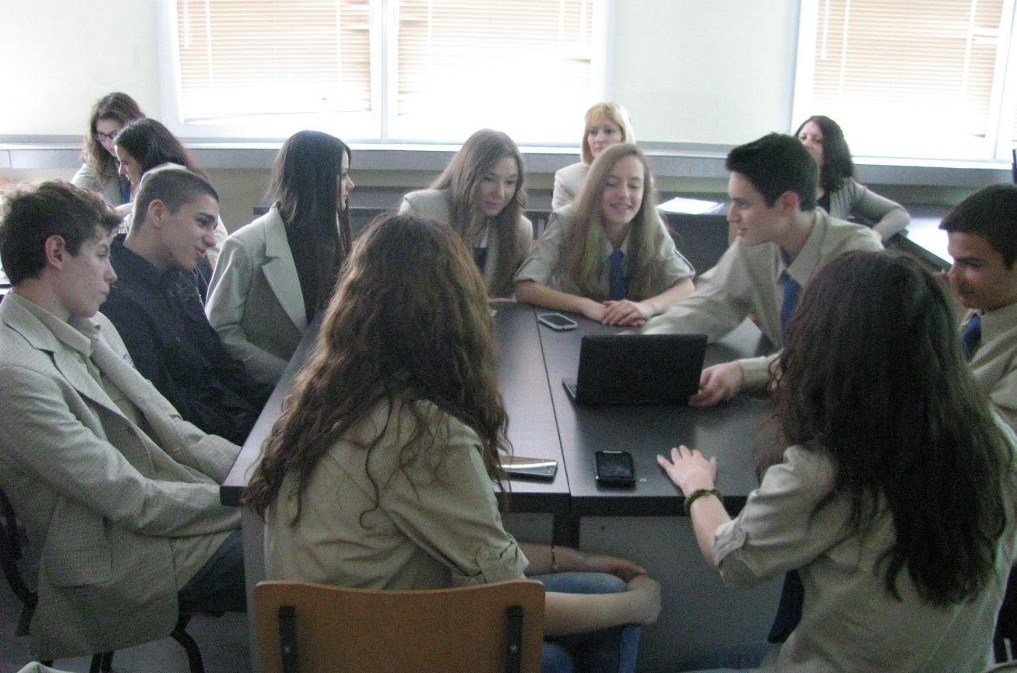
Tablets
During the year I make special lessons in which I divide the classes into groups. They work with tablets, find information and facts on the internet and solve problems.

Slide 12
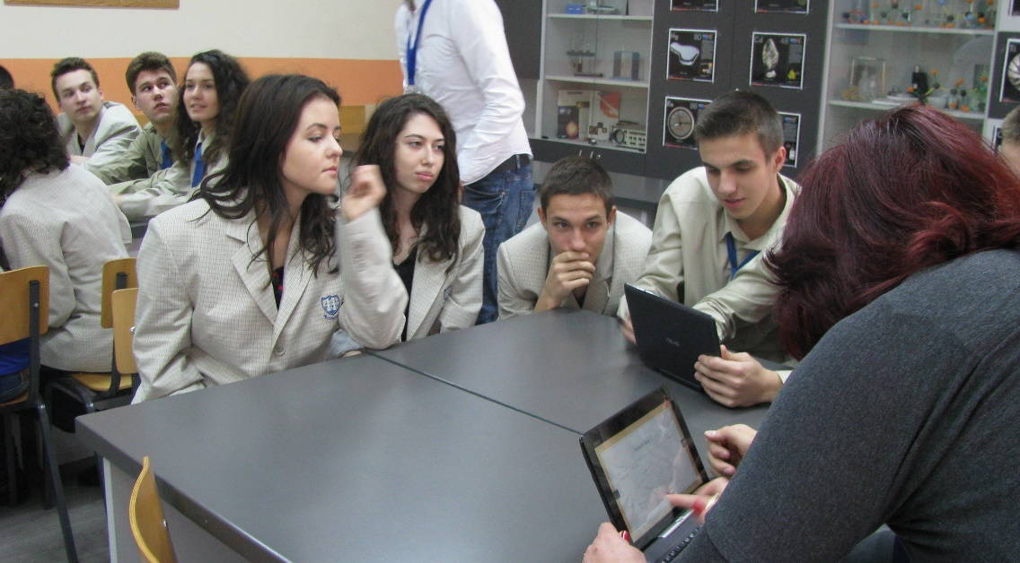
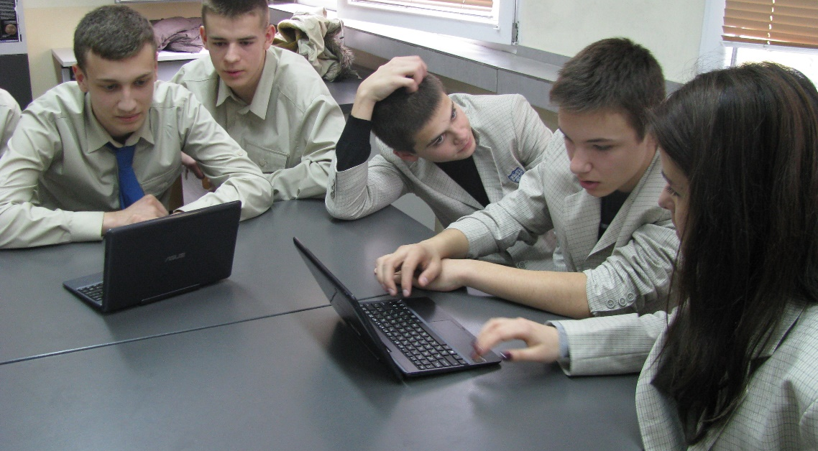

Slide 13

Thank you for the attention!
Rositsa Sotirova – Second English Language School "Thomas Jefferson“

